Slide 1
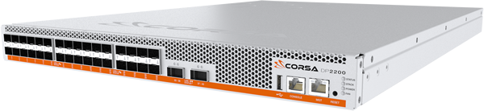
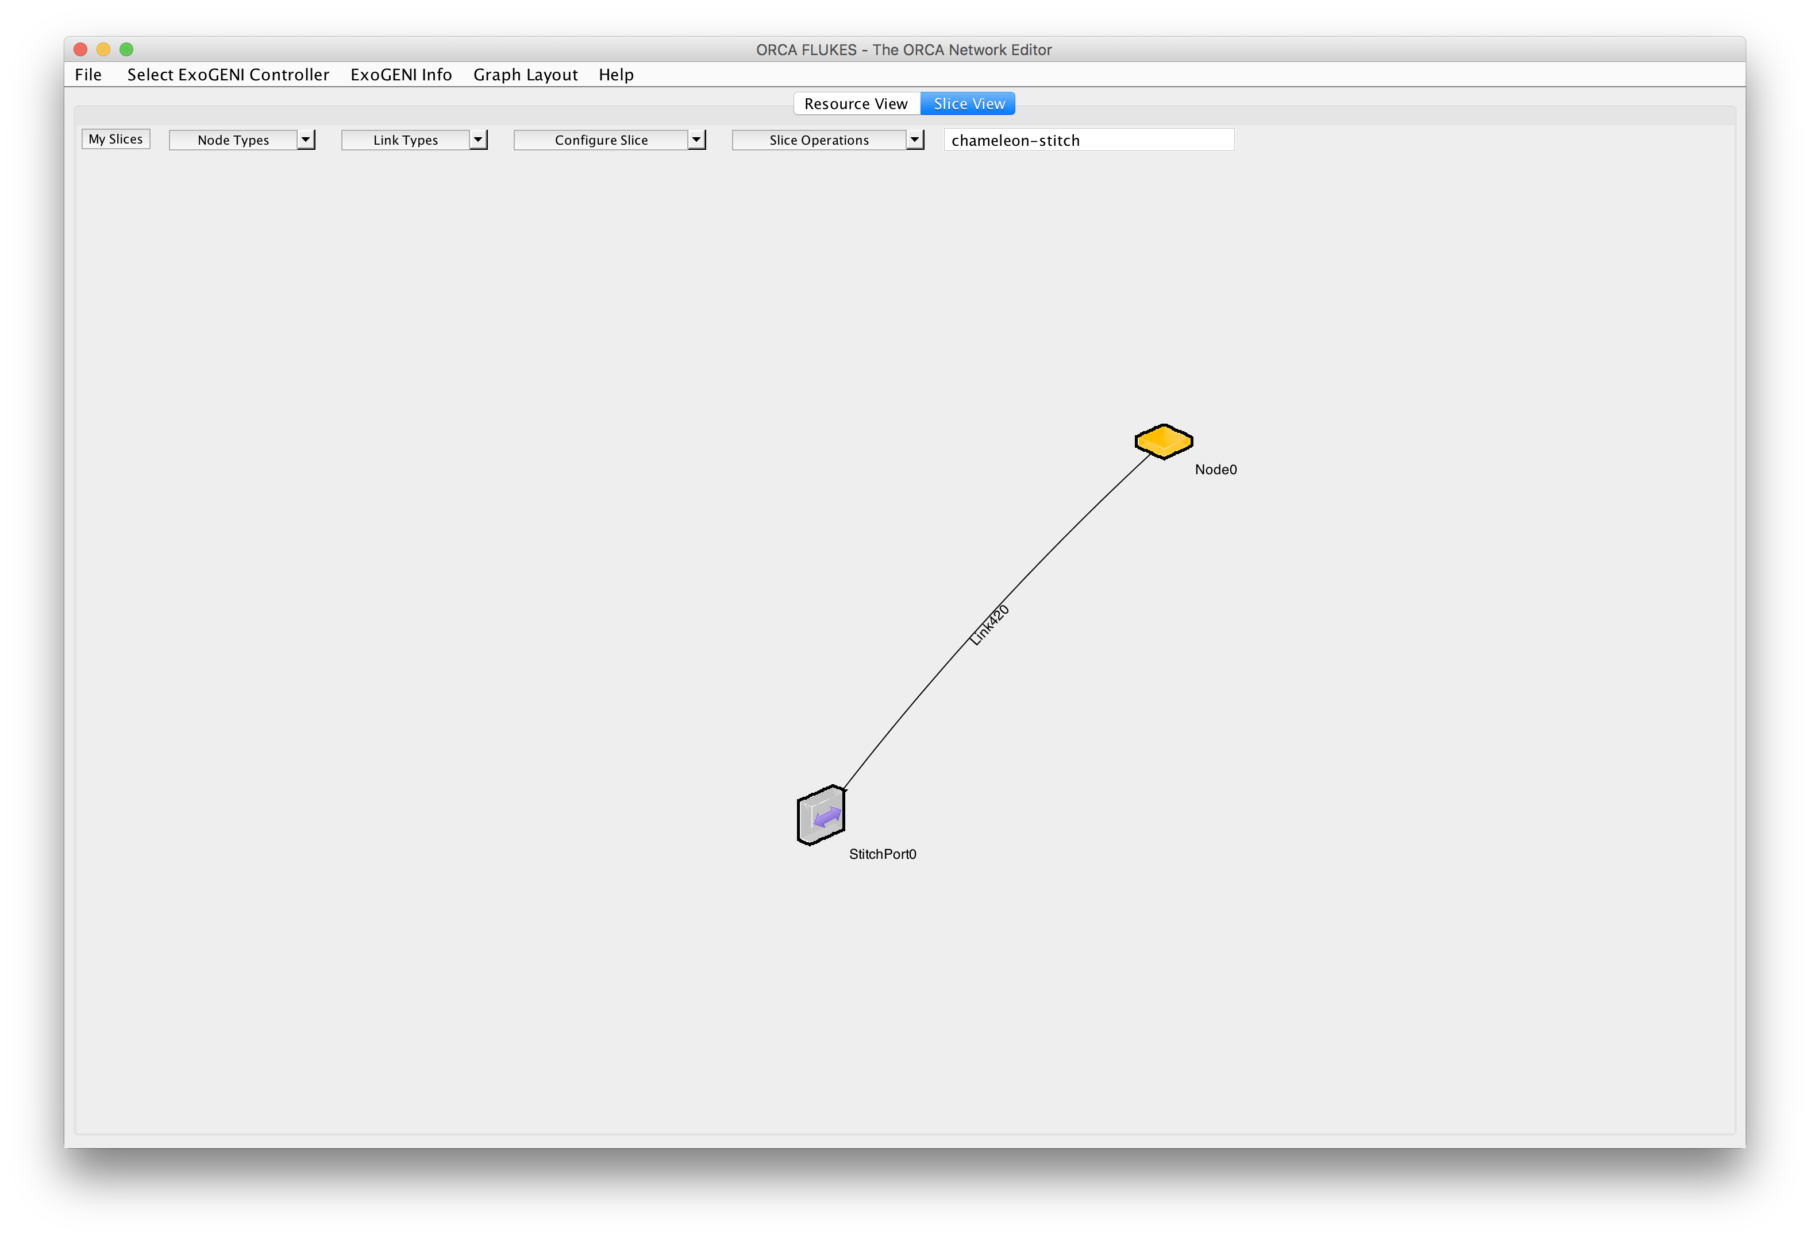



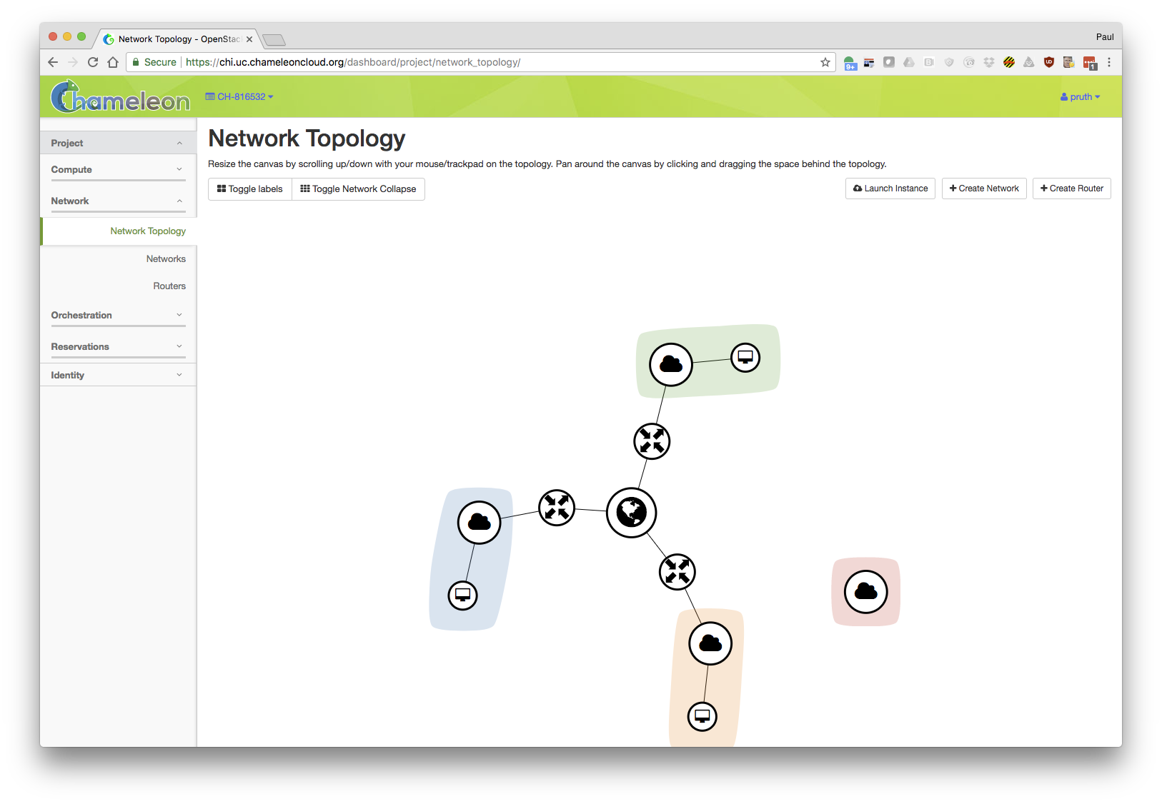
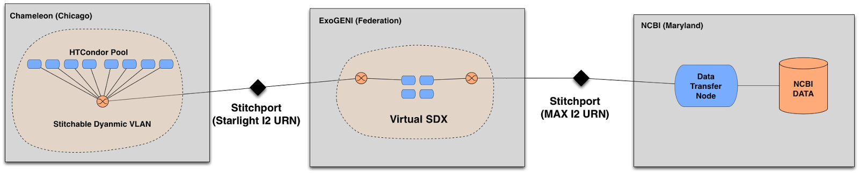





Networking for NSF Cloud Chameleon:
Phase 2 Plans and ExoGENI Stitching Prototype
Chameleon and ExoGENI
Paul Ruth (PI) pruth@renci.org
Bonus Demo:
SciDAS Workflow Direct Connection between Chameleon and NCBI using ExoGENI
Chameleon Phase 2 Networking Plans
Demo: Chameleon to ExoGENI Stitching Prototype
Chameleon Phase 2:
  RENCI added to the team.
Hardware Network Isolation:
  Corsa DP2000 series switches
  OpenFlow 1.3
  Sliceable Network Hardware
  Tenant controlled Virtual Forwarding Context (VFC)
Isolated Tenant Networks
  BYOC – Bring your own controller
Wide-area Stitching
  Between Chameleon sites at 100 Gbps
  External partners (GENI, AL2S, ScienceDMZ)
AL2S, GENI, Future Partners
Austin
Chameleon Core Network
100Gbps uplink public network
Chicago
Corsa
DP2400
Switch
ExoGENI slice
Dynamic Chameleon Stitchport
VFC
(Tenant A)
VFC
(Tenant b)
Compute
Node
(Tenant A)
Compute
Node
(Tenant A)
Compute
Node
(Tenant B)
Compute
Node
(Tenant B)
OpenFlow Controller (Tenant A)
Ryu
OpenFlow Controller (Tenant B)
Stitched L2 path
Bonus Demo: Chameleon to NCBI via ExoGENI
Dynamic VLANs
Connectivity to ExoGENI Stitchport
Network Innovators Community Event (GENI NICE)
October 10, 2017
Toronto, Canada

